Slide 1

Python Programming
Syntax, Variables, Conditionals, Loops, and List Comprehensions

Slide 2

Module 1
Syntax, Variables, & Data Types

Slide 3

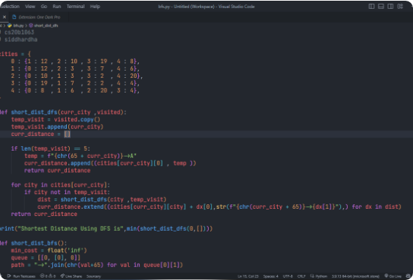
What is Python?
Python is a high-level, interpreted programming language renowned for its simplicity and readability.
•
Readable Syntax: Emphasizes plain English keywords.
•
Interpreted: Code is executed line by line in real-time.
•
Dynamically Typed: No need to explicitly declare variable types.
•
Multi-Purpose: Used in Web, AI, Data Science, and Automation.

Slide 4






Python Syntax & Indentation
Indentation Defines Blocks
Clean & Readable Syntax
Unlike languages using curly braces {}, Python relies on whitespace indentation to define code structure and scope.
Python avoids unnecessary semicolons ; at line ends, keeping scripts clean, succinct, and easy to maintain.
if
print
"Indented 4 spaces"
# This is a clean comment
10
20

Slide 5





Variables & Naming Rules
Creating Variables
Naming Rules & Convention
Variables store data values in memory. They are created instantly upon assigning a value with the = operator.
Names are case-sensitive, must start with a letter or underscore, and use snake_case for multiple words.
25
"Alice"
True
21
# Good
5
# Valid
# 2user = 10 # Invalid!

Slide 6
Core Built-In Data Types
Data Type | Type Name | Example | Description
Integer | int | 42, -7 | Whole positive or negative numbers without decimals.
Float | float | 3.14159, -0.5 | Real numbers containing decimal points.
String | str | "Hello Python" | Sequence of textual characters wrapped in quotes.
Boolean | bool | True, False | Truth values representing logical binary conditions.
List | list | [1, "apple", True] | Ordered, mutable collection of arbitrary items.

Slide 7
Module 2
Input & Output Operations

Slide 8





Input & Output Functions
Output with print()
Input with input()
Prints text or evaluation results to the console. Supports string formatting with f-strings.
Captures user keyboard input as a string. Convert types explicitly using functions like int().
name = "Bob" score = 95 print(f"User {name} scored {score}")
user_str = input("Enter age: ") age = int(user_str) # Cast string to int

Slide 9
Module 3
Control Flow: Conditionals

Slide 10
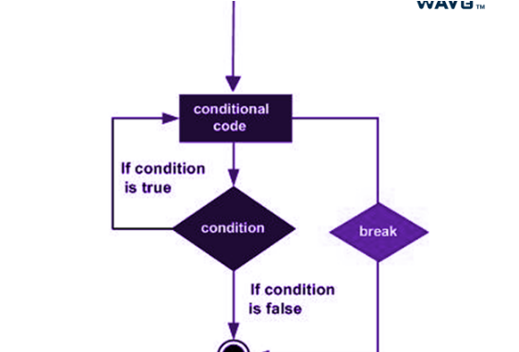

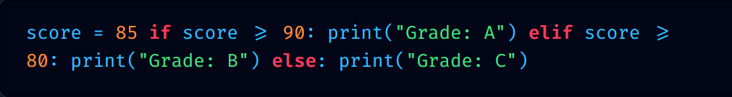
Conditional Logic (if-elif-else)
Conditionals execute specific code blocks based on whether logical statements evaluate to True or False.
85
if
90
print
"Grade: A"
elif
80
print
"Grade: B"
else
print
"Grade: C"

Slide 11







Operators for Logic
Comparison Operators
Logical Operators
Compare two operands and return boolean flags.
Combine multiple conditional expressions together.
# Greater than
# Equal to
# Not equal to
# Both conditions must be True
# At least one condition True
and
# Less than or equal
or

Slide 12
Module 4
Control Flow: Loops

Slide 13

Iteration with For Loops
Sequence Iteration: A for loop iterates through items in sequences like lists, tuples, or strings.
The range() Function: Generates sequence of numbers on the fly (e.g., range(5) yields 0 through 4).
Syntax Example:

Slide 14

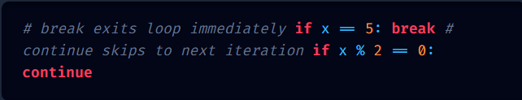



While Loops & Loop Controls
The while Loop
Loop Control Keywords
Repeats execution continuously as long as its target condition remains True.
Keywords to modify loop flow dynamically.
# break exits loop immediately
# continue skips to next iteration
if
5
break
1
while
3
print
1
if
2
0
continue

Slide 15
Module 5
Python List Comprehensions

Slide 16

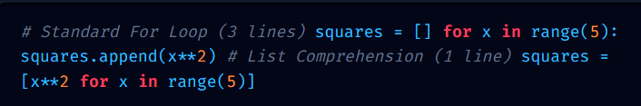

Elegant List Comprehensions
List comprehensions offer a concise, readable syntax for creating new lists based on existing iterables.
# Standard For Loop (3 lines)
for
in
range
5
append
2
# List Comprehension (1 line)
2
for
in
range
5

Slide 17
Practical Lab
1-Hour Hands-On Coding Challenges

Slide 18






Daily Practical Lab Tasks
Ex 1: User Profile Script
Ex 2: Grade Calculator
Ex 3: List Filter
Prompt user for name and age, compute target birth year, and print a formatted greeting message using input() and print().
Ask for numerical score input and return letter grade using an if-elif-else conditional block with validation checks.
Convert a multi-line loop that filters even numbers from a list into a single-line list comprehension with condition.

Slide 19
Questions & Answers
Thank you for participating in today's Python workshop!

